Slide 1
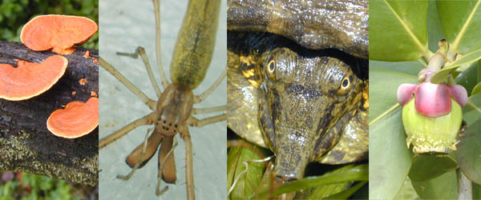
GENERAL BIOLOGY fdn 1203
Dr. Theja Abayarathna
Department of Biology
Faculty of Applied Sciences
Rajarata University of Sri Lanka

Slide 2
Kingdom 3: PROTISTA (Algae & slim moulds)
All are Eukaryotes
All algae contain Chlorophyll a
Depending on the type of algae along with chlorophyll ‘a’ they can have ‘chlorophyll b’, ‘c’, ‘d’ or ‘e’
Thus these algae are all photosynthetic protista.

Slide 3
Algae may occur in oceans, lakes, tanks, rivers streams and also in damp soil and on bodies of other organisms.
Ex. Clamidomonas, Spirogyra

Slide 4
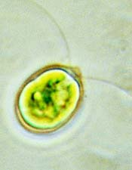
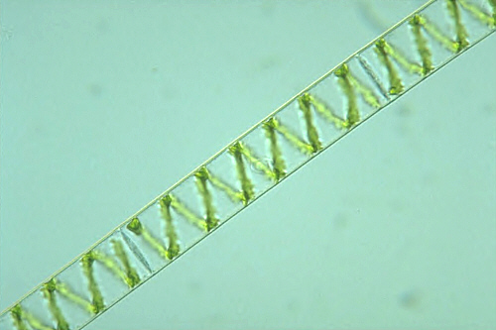
Clamidomonas
Spirogyra

Slide 5
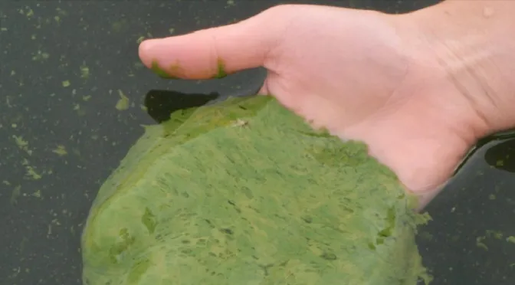
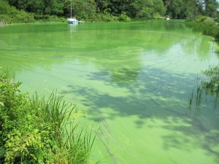
Algal blooms in water bodies

Slide 6
Kingdom 4: Fungi
non-photosynthetic (no chlorophyll so can’t produce their own food), eukaryotic organisms
heterotrophic (get their food from others)
Most are small, microscopic, filamentous branched forms that bear spores

Slide 7
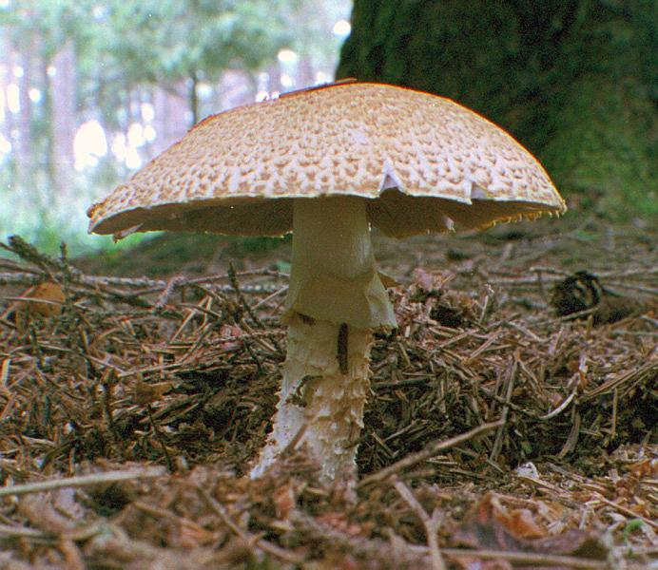
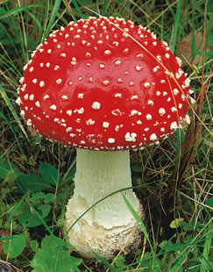
Ex. mushrooms

Slide 8
Kingdom 5: Plantae
Two types of plants as vascular or non-vascular
Non-vascular plants are more primitive
Ex.
Thalloid liverworts
Mosses
ferns

Slide 9
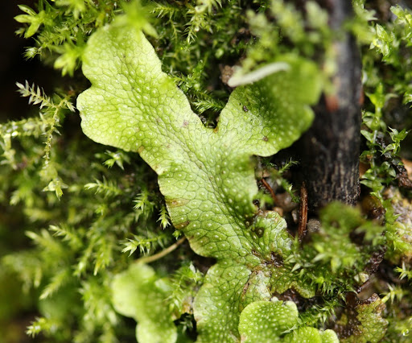
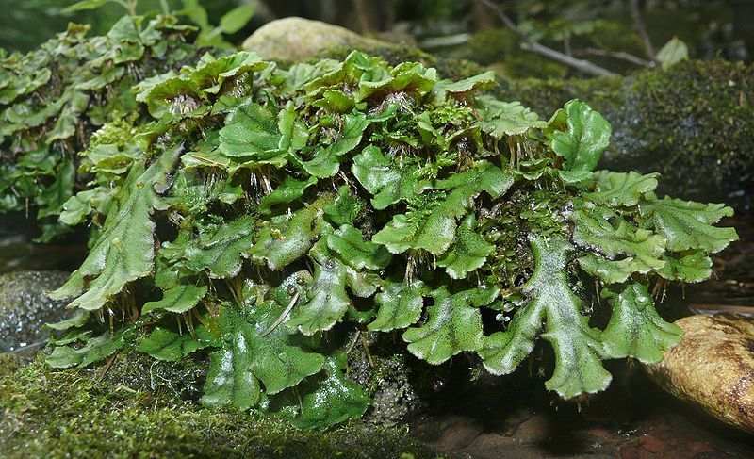
Thalloid liverworts

Slide 10
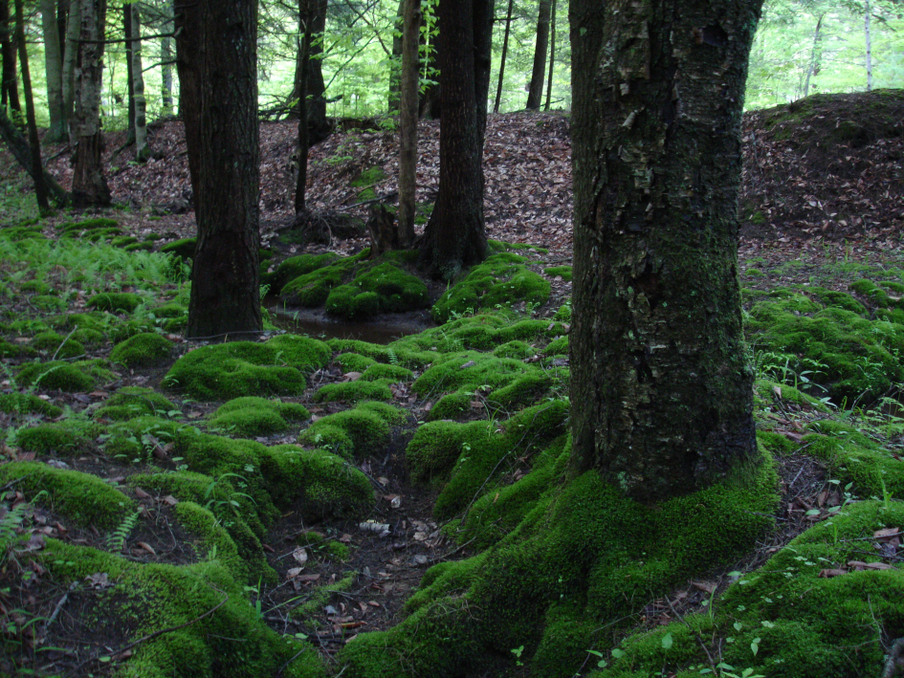
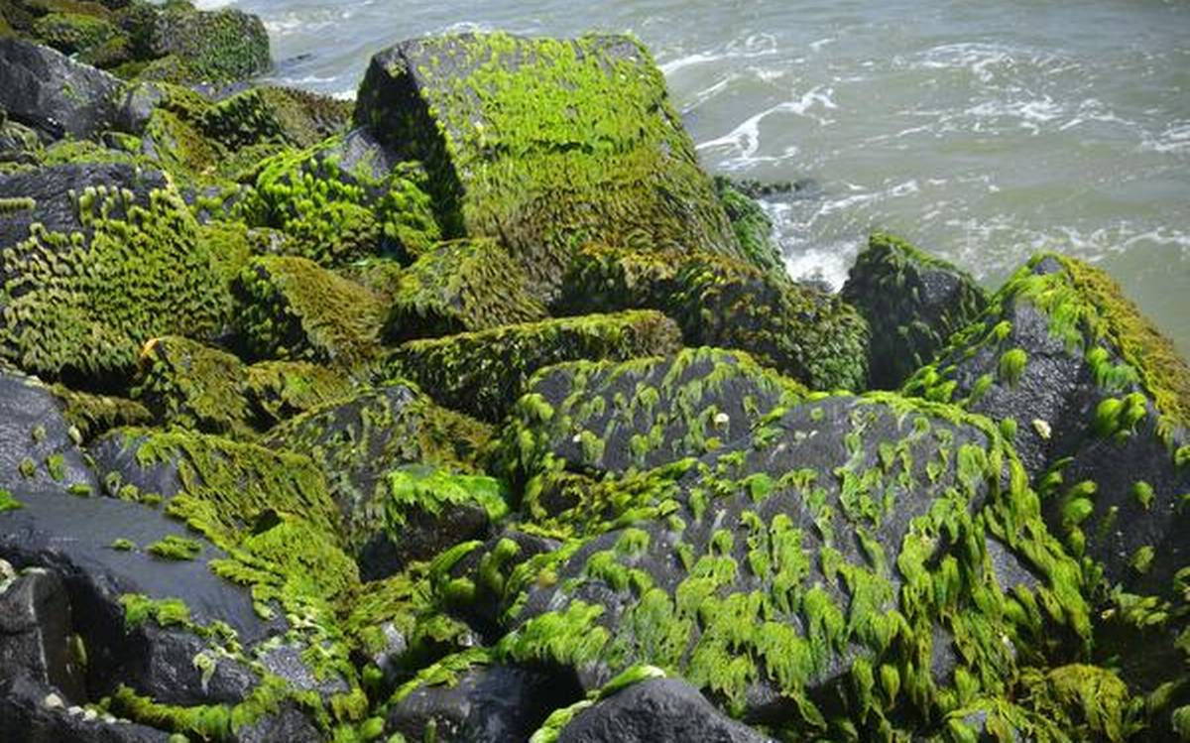
Mosses

Slide 11
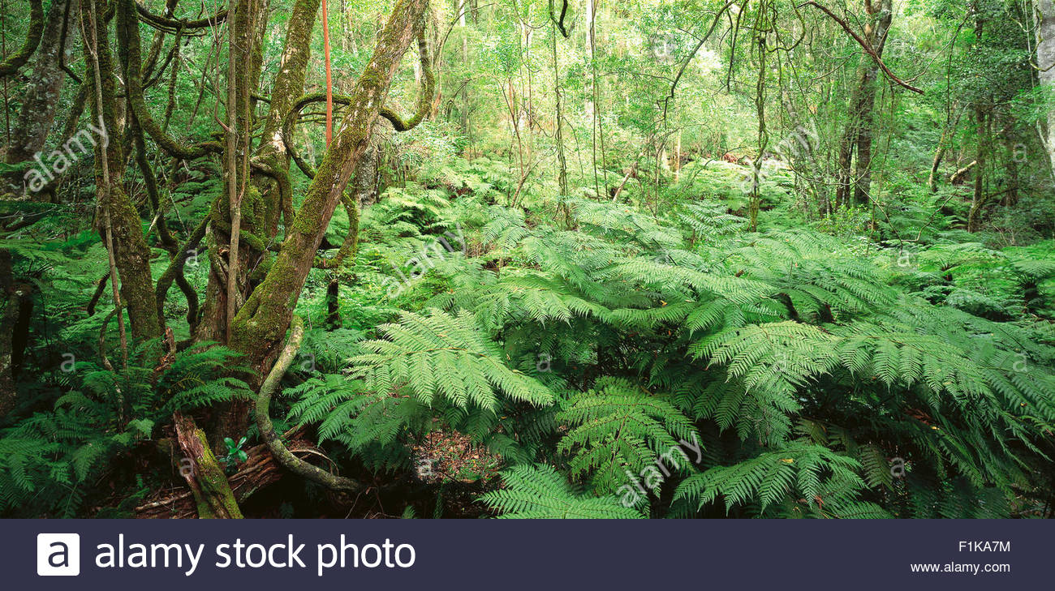
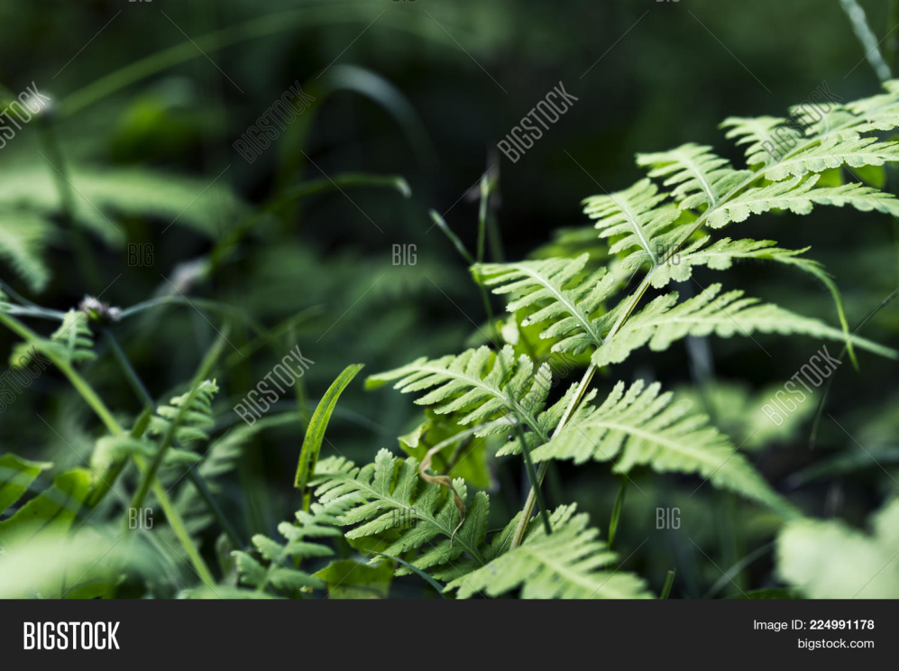
Ferns

Slide 12
Vascular plants
Can be of two types,
Open seeded plants (Ex Cycas)
Enclosed seeded plants
Can be
Dicot plants
Monocot plants

Slide 13
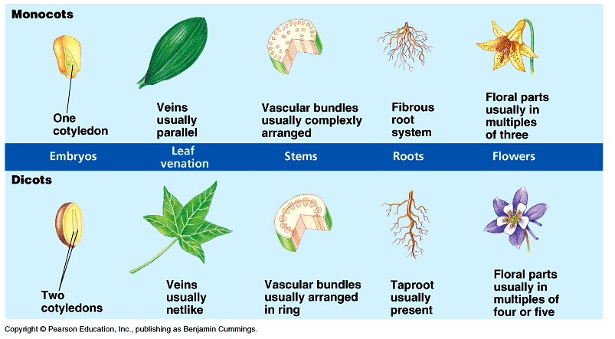
Differences between dicot and monocot plants

Slide 14
Activity: Draw a flow chart to show the classification of Kingdom Plantae

Slide 15
Kingdom 6: Animalia
This kingdom consists of
multicellular (composed of more than one cell)
heterotrophic (feed on other organisms – cant produce their own food)organisms
Divided into 2 main Groups
Invertebrates
Vertebrates

Slide 16
Invertebrates
Consists of
Porifera –Sponges
Cnidaria
Plathihelminthes
Nematoda
Annelida
Mollusca
Arthropoda
Echinodermata

Slide 17
Vertebrates -
Consists of
Pisces - Fish
Amphibia
Reptilia
Aves - Birds
Mammalia

Slide 18
Thank you!
See you in next class !

